Slide 1
Live Life. Give Life. Make the decision.
Be an organ, eye and tissue donor.

Slide 2
Who is LifeShare of Oklahoma?
We are a private, not-for-profit 501 © 3 organization certified and designated by the U.S. Department of Health and Human Services as the organization dedicated to recovering organs and tissue for transplantation in all 77 counties of the state of Oklahoma.
OPO refers to Organ Procurement Organization.

Slide 3
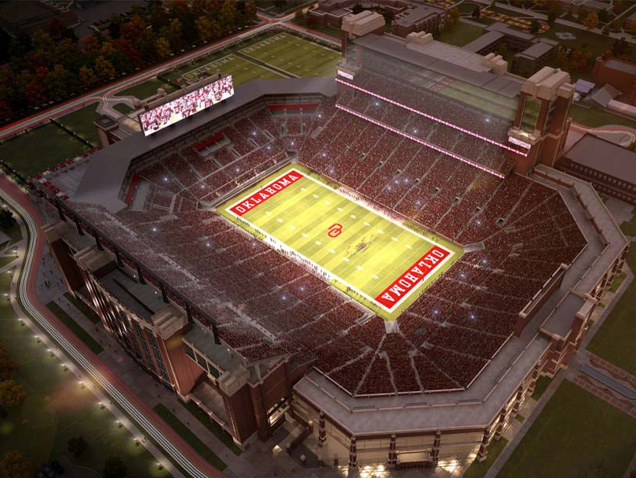
OU Memorial Stadium Holds
88,000
National Transplant
Waiting List
106,000

Slide 4
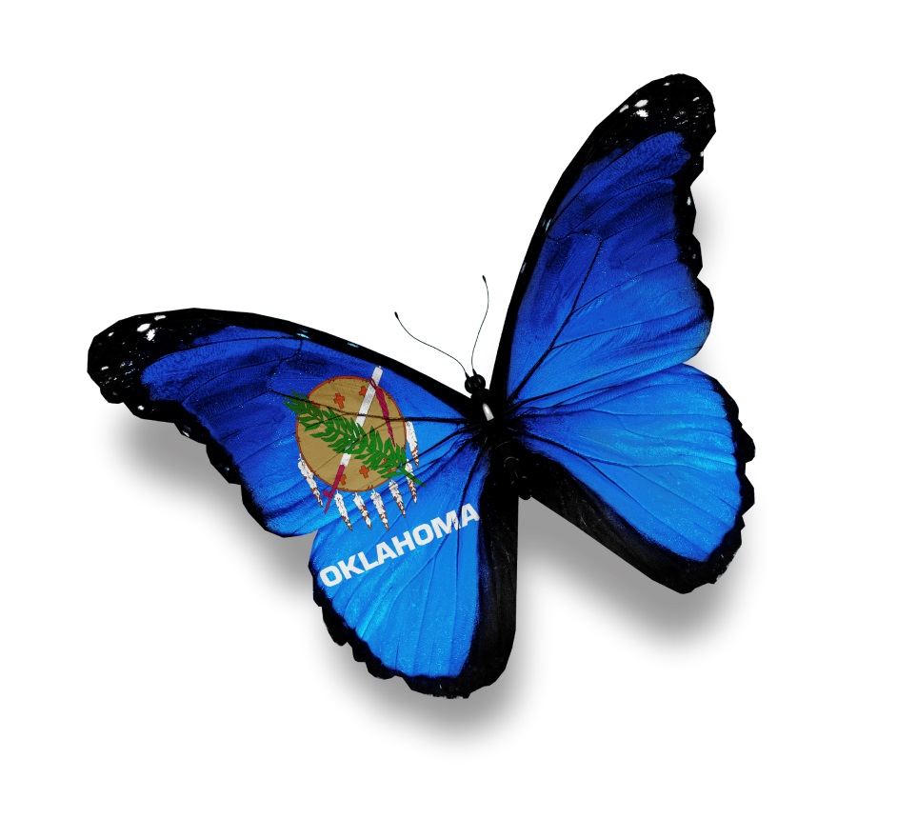
605
Oklahomans
are on the
waiting list.

Slide 5
Every day in the U.S.
on average,
17 people die
waiting for a transplant

Slide 6
Every 9 minutes someone is added to the National Transplant Waiting List

Slide 7
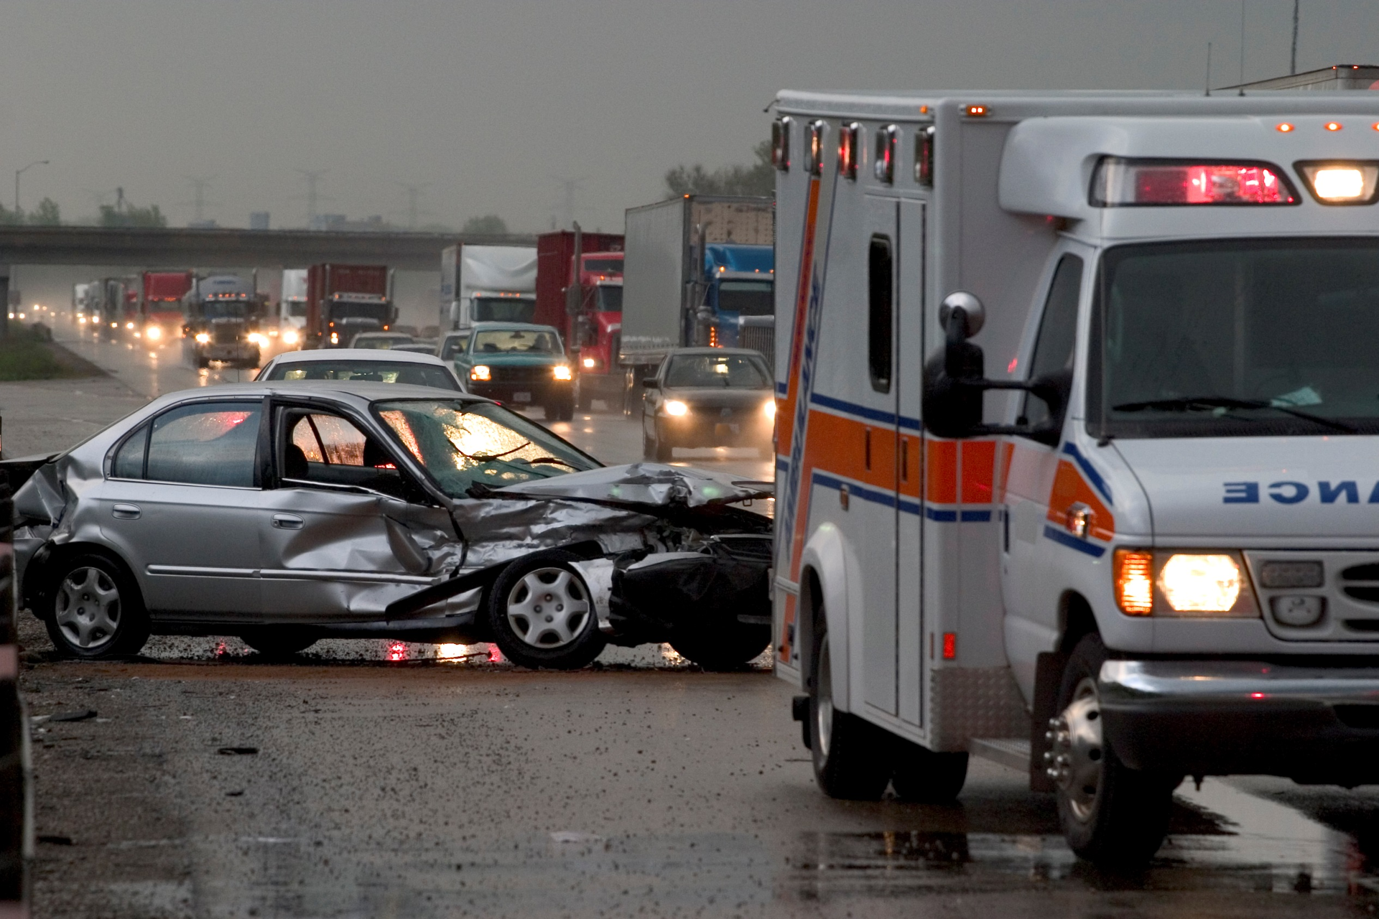
The Truth About Donation
If you are sick or injured and admitted to the hospital, the number one priority is to save your life. Organ donation can only be considered after death has been declared by a physician.

Slide 8
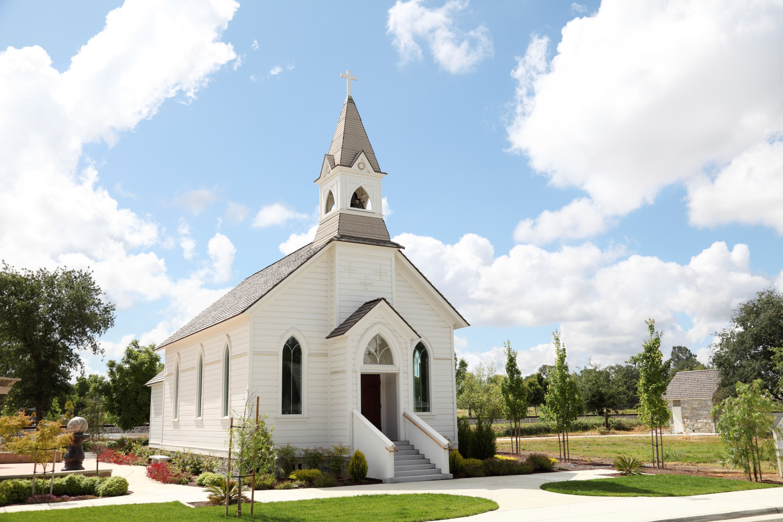
The Truth About Donation
All major organized religions approve of organ and tissue donation and consider it an act of charity.

Slide 9
The Truth About Donation
Your medical condition and social history at the time of death will determine which organs and tissue can be donated, not your age. LifeShare suggests that you do not rule yourself out as a donor due to age.

Slide 10
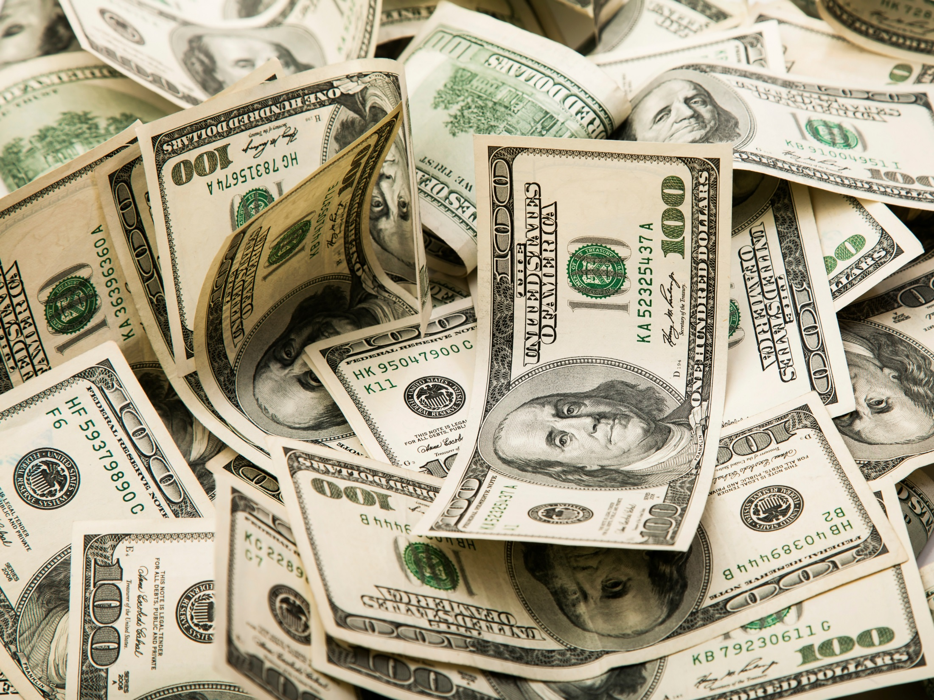
The Truth About Donation
Donation does not cost the family of the donor anything. LifeShare of Oklahoma pays for all procedures, tests or evaluations needed for donation. Funeral costs remain the responsibility of the family.

Slide 11
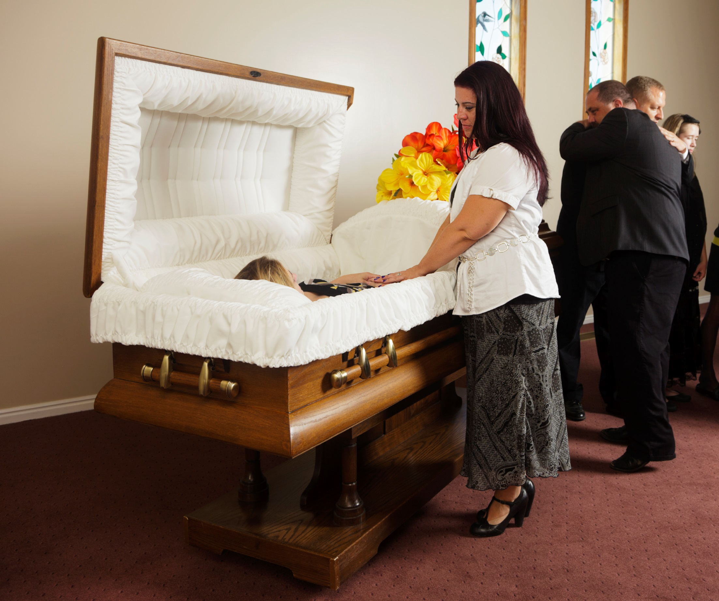
The Truth About Donation
Donation does not change the appearance of the body for the funeral service. An open casket service is still a viable option after donation.

Slide 12
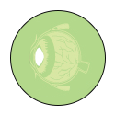
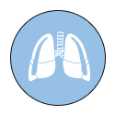
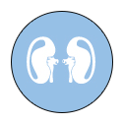
Transplantable Organs and Tissue
HEART
CORNEA
LUNGS
TENDONS
LIVER
VALVES
KIDNEYS
VEINS
INTESTINE
SKIN
PANCREAS
BONES

Slide 13
One Donor Can . . .
Save the lives of up to
eight people
through organ donation

Slide 14
One Donor Can . . .
Enhance or improve the lives of up to
75 people
through tissue donation

Slide 15
Making the Decision to be a Donor
Anyone under 18 can register their INTENT to become a donor.
However, it is important to talk to your family and share your decision to be a donor.
Until you turn 18 your parents will have to give their CONSENT for you to donate.
Once you are 18 it will be your decision only.

Slide 16
Making the Decision to be a Donor
Register at the Tag Agency when you get your license or state ID card
The red heart does not have to be on your license to be a registered organ donor
Visit www.LifeShareRegsitry.org
Call 1-800-826-LIFE and request a donor registration card

Slide 17
Connect to Learn More
www.LifeShareOK.org
www.Facebook.com/LifeShareOK
@LifeShareOK
LifeShareOK

Slide 18
